Slide 1
Task 5:Data Story telling
Presented By: S.Vaishnavi
Tools Used: Python, Pandas, Matplotlib, Seaborn, Jupyter Notebook

Slide 2
Project Overview
Objective:
Transform raw data into meaningful
business stories through data analysis and
visualization
Goals:
Analyze sales performance
Indentitfy trends and patterns
Discover business opportunities
Communicate insights effectively

Slide 3
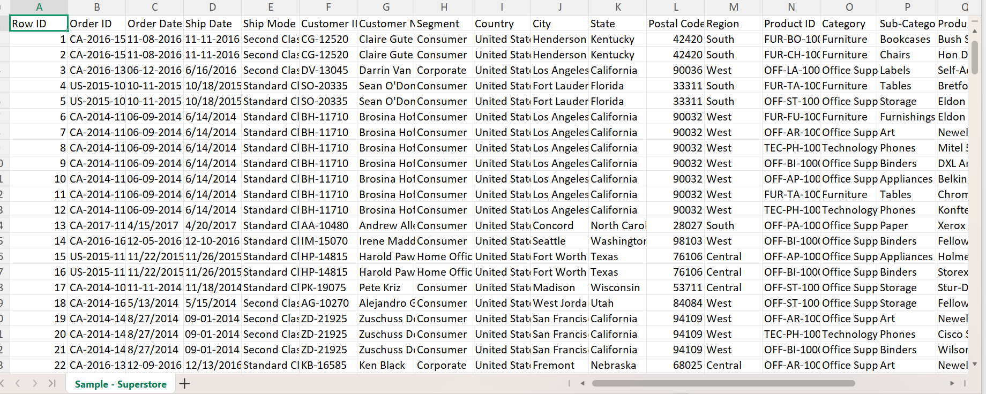
Dataset information
Dataset used:
Sample superstore dataset
Key features:
Order data
Sales
Profit
Category
Sub category
Region
Customer segmentation

Slide 4
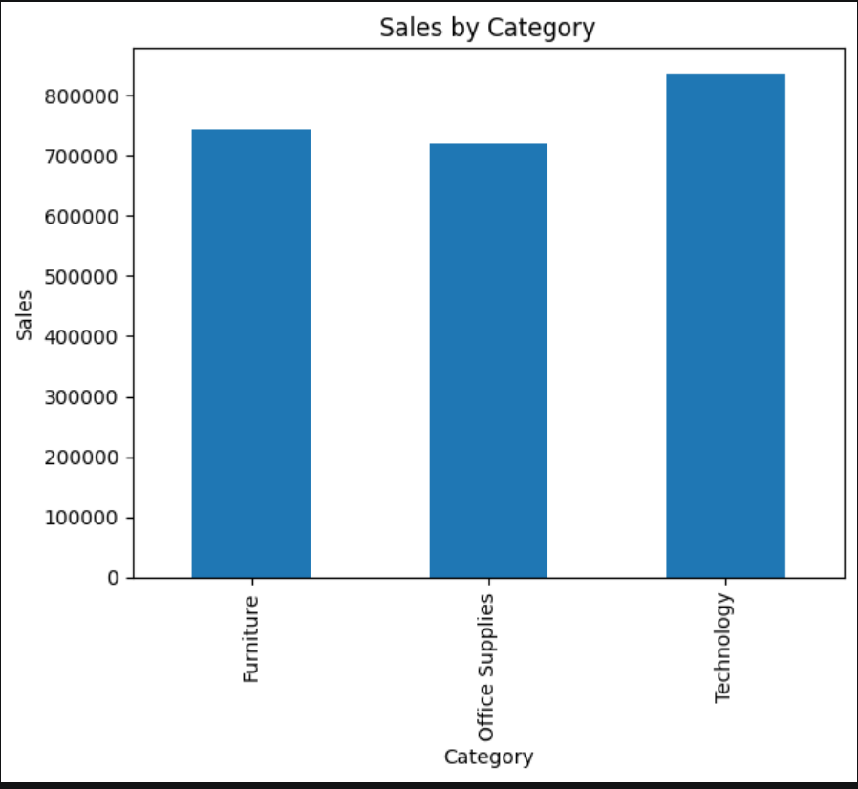
Data Cleaning & Preparation
Steps Performed
✔ Imported dataset using Pandas
✔ Checked missing values
✔ Removed duplicates
✔ Converted date columns
✔ Verified data types

Slide 5
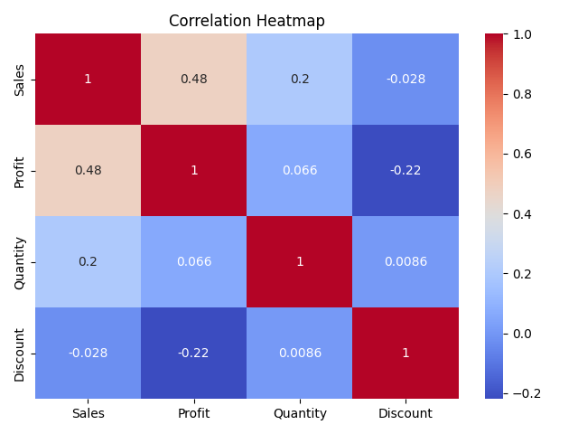
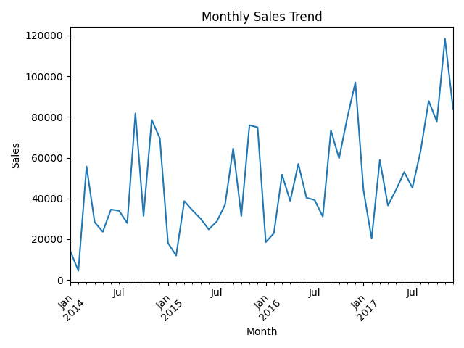
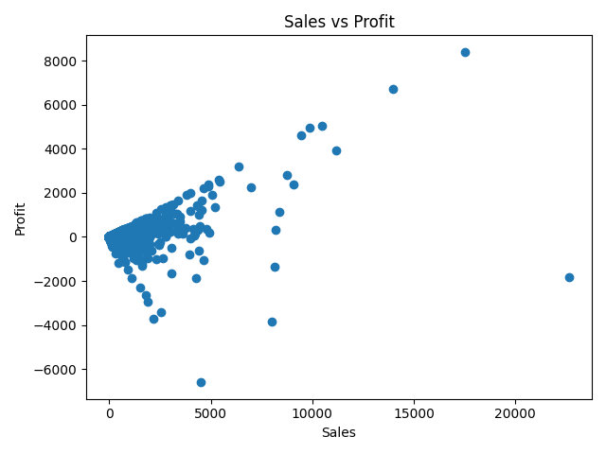
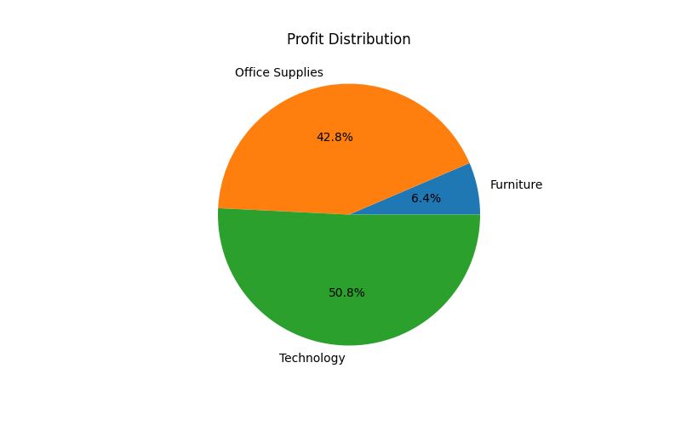
Exploratory Data Analysis
Analysis Conducted
Sales Trend Analysis
Profit Analysis
Category Performance
Regional Performance
Customer Segment Analysis
Tools Used
Pandas
Matplotlib
Seaborn

Slide 6
Key Business Insights:
Insight 1
Technology category generated the highest sales.
Insight 2
Certain sub-categories showed low profitability despite strong sales.
Insight 3
West Region contributed significantly to overall profit.
Insight 4
Consumer Segment was the largest revenue contributor.

Slide 7
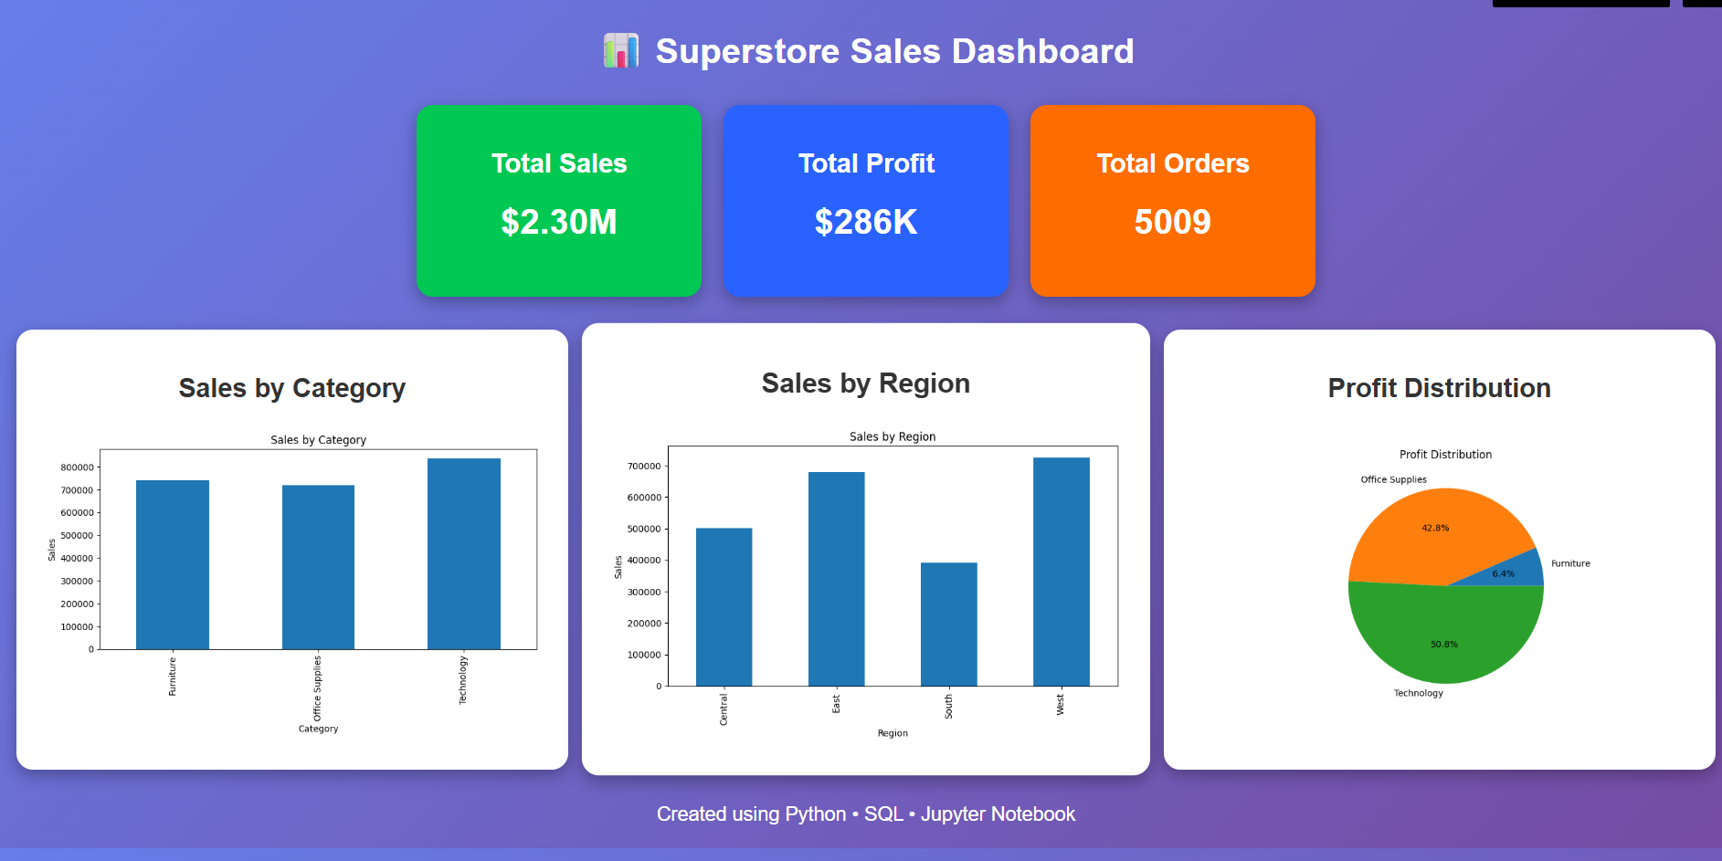
Data Story & Recommendations
Business story:
The analysis revealed that while sales are growing steadily, profitability varies significantly across categories and regions.
Recommendations:
Focus marketing on high-profit categories.
Improve performance of low-profit products.
Expand successful regional strategies.
Monitor customer segments with highest revenue contribution.

Slide 8
Conclusion:
Data storytelling tranforms numbers into actionable business decisisons.
Skills Demonstrated:
Data cleaning
Exploratory Data analysis
Visualization
Insight generation
Storytelling with data

Slide 9
Thank you

